Slide 1



Welcome to Reception!
Dragonfly
Ladybird

Slide 2
Reception Staff
Dragonfly Class
Teacher: Mrs Spickett and Mrs Hills
Teaching Assistants: Mrs Slade and Miss Bull
Ladybird Class
Teachers: Mrs Vanstone
Teaching Assistant – Miss Pochylea and Miss Carroll

Slide 3
Other School Staff
Headteacher: Mr Garratt
Head of School & Head of Inclusion: Mrs Roberts
Head of School & Head of Teaching & Learning: Mrs Long
SRP Headteacher: Ms Fuller
Head of EYFS & KS1: Miss Cygan
Head of KS2: Mrs Douglas
Family Liaison Officer: Mrs Sands and Mrs Farrell
SENDCO: Mrs McGuirk
Safeguarding Officer: Mrs Turner

Slide 4

Expectations
At Holy Trinity & St John’s we follow the 3 school rules; ready, respectful and safe.
Children are reminded what these look like and this is constantly being reinforced through-out the school.
Over the term we will be spending time embedding these within the classroom environment.

Slide 5
EYFS at HTSJ
At Holy Trinity and St John’s we believe children learn best through play and experiences. This is why play underpins our curriculum in the EYFS, where we use the children’s interests to develop their communication, language and learning skills. In reception we provide an array of opportunities for experiences such as visitors from the community, using our indoor and outdoor classrooms as well as visits to a variety of places within our community.
Inside our classrooms include a range of continuous provision, including role play areas, book corners, art and craft areas and exploration areas. We also have a regulation space which children are able to use freely. Our EYFS area is set up as a free flow environment, meaning that each classroom has specific areas for learning and the children are encouraged to explore both classrooms to develop their learning through their own interests. We also have our outdoor classroom which children will use all year round.
We use an online journal, Tapestry, to record the children’s achievement in their child-initiated activities. Parent’s/carers are able to add photographs and information to their child’s journal. This enables us to celebrate a child’s achievements at home as well as school.

Slide 6
General Information
Children are expected to read at least three times a week. They will be rewarded with house points for doing so. Home books are meant to be easily achievable so that you are able to celebrate the children’s success with them.
Children will be sent home learning each week that we encourage children to complete.
Children will receive a snack each day, this will be fruit and/or vegetables. Children should bring a water bottle to school every day, with only water in it.
All children are entitled to a free school meal everyday up until Year Two. They can also bring a healthy packed lunch. We are a strictly nut free school.

Slide 7




Holy Trinity Rewards
All children start the day on Bronze.
They are removed from Bronze if after a verbal warning they are still not responding and doing the right thing or if they have deliberately hurt another child.
Children can progress to silver, gold and HT champion during the day through showing good effort, achievement or acts of kindness.
House points are awarded at the end of the day according to where they finish on the chart.
Children also have opportunities to earn House points by meeting other class expectations.
Holy Trinity Champion – 5hps
Gold – 3hps
Silver – 2hps
Bronze – 1hp

Slide 8
What is EYFS?
The EYFS is a curriculum for all Early Years settings from birth to 5.
The EYFS prepares children for learning in their future school life.
The EYFS begins when a child attends a nursery or pre-school setting or if they are cared for by a childminder.
The final stages of the EYFS are planned for when your child is in a Reception class of a primary school.

Slide 9
Areas of Learning and Development
There are seven areas of development.
Three Prime
Personal social and emotional development
Physical Development
Communication and language
Four Specific
Literacy Mathematics
Understanding the world Expressive arts and design

Slide 10
Personal, Social and Emotional Development
Making friends.
Learning rules.
Learning daily routines.
Learning about other cultures and respect.
Understanding boundaries.
Making relationships with adults.

Slide 11
How Can You Help at Home?
Support your child to respond to different activities and events talking about their feelings.
Play games which encourage sharing and turn taking which will help your child to build their social skills.
Teach them to use the toilet independently, dress themselves and use a knife and fork.

Slide 12
Physical Development
Supports children’s understanding of a healthy and safe development.
Provides opportunities for using a range of large and small equipment.
Helps children to develop a sense of space around themselves and others.
Encourages children to explore balancing travelling and climbing equipment.
Develops children's practical skills such as dressing, undressing and using the toilet.

Slide 13
How can you help?
Give your child time to run, jump, climb and play outdoors.
Share stories about being healthy, choosing the right food, drinking water and getting plenty of sleep.
Encourage your child to participate in activities such as building, drawing, threading beads, playing with water, flexible materials, for example play dough plasticine, and construction.
Encourage and support your child to independently use the toilet.

Slide 14
Communication and Language
Conversational skills.
Listening and concentration skills.
Children's abilities to respond to and follow instructions.
Vocabulary.
Role play

Slide 15
How can you help?
Encourage your child to listen and respond appropriately
Encourage your child to engage in conversations with new people.
Encourage your child to pose questions that use why, how, where, what, when and who.
Take time to listen to your child talking about things they’ve done and answering their questions.

Slide 16
Literacy
Hearing and saying letter sounds in words such as s-a-t
Recognising and writing their own name
Continuing rhymes- cat, bat, hat etc.
Listening to and talking about stories

Slide 17
How can you help?
Share stories and books at home and talk about the characters.
Sing simple familiar rhymes.
Have fun with chalks, crayons, and whiteboards. Write lists, letters and do patterns.
Play imaginative games and dress up as different characters.
Look out in the environment for familiar letters and words.

Slide 18
Mathematics
Numbers
Counting
Adding and subtracting
Shape, space and measure
Recognising and creating patterns

Slide 19
How can you help?
Talk about the shapes you can see in the environment.
Comparing things which are heavy and light or long and short.
Look out for numbers in and out of the home.
Singing counting songs and rhymes.
Counting, adding and subtracting anything and everything - socks, cars, shopping, cutlery, fingers and toes!
Cooking

Slide 20
Understanding the World
Helps children to gain an understanding of their world.
Finding out about other people and places.
Encourages children to look at changes in their life
Encourages them to explore and investigate.
Make observations of animals, plants and talk about changes and differences.

Slide 21
How can you help?
Talk with your child about the places they go and things they see in the world around them.
Answering and encouraging questions - What if…? Why do you think…? How did you…?
Letting children join in with everyday activities - washing up, cooking, shopping, helping in the garden...
Lots of opportunities to explore inside and outside in a variety of environments.

Slide 22
Expressive arts and design
Role play
Singing and dancing
Exploring and experimenting with different materials
Use simple tools to construct and make.

Slide 23
How can you help?
Talk with your child about their imaginative play and join in if possible!
Have junk modelling sessions and see what you can create.
Paint a picture and not necessarily on a piece of paper.
Play musical instruments.
Dance to your favourite music.

Slide 24
Foundation Stage Profile
Throughout the coming year your child will be working towards achieving these Early Learning Goals.
Your child’s class teacher will collect evidence.
This information will be collated in your child's Learning Journey
A final assessment will be made at the end of the year using all the evidence collected.
This assessment will then be used to inform the Year 1 teacher and the Local Education Authority of your child's achievements.

Slide 25
Foundation Stage Profile
If your child has attended a setting before coming to school they will have provided us with an overview of their achievements.
This information will be used to inform our planning, and will be the basis of how we determine the next steps.
We will also be using the information you provide us with during your parent interviews to help us plan and shape our teaching to best fit the needs and interests of the children.
We will regularly re-visit the children interests to ensure our teaching is stimulating and relevant for the children in each class.

Slide 26
Foundation Stage Profile
By the end of Reception some children will have achieved some of the ELG goals.
For those children who are still working towards achieving these the Foundation stage will continue into Year 1.
Parents will be updated at regular intervals throughout the year on their child’s progress.
Parents will be given regular opportunities to view their child's learning journey.
Parents will receive an end of year report in Summer detailing their child’s progress and next steps.

Slide 27
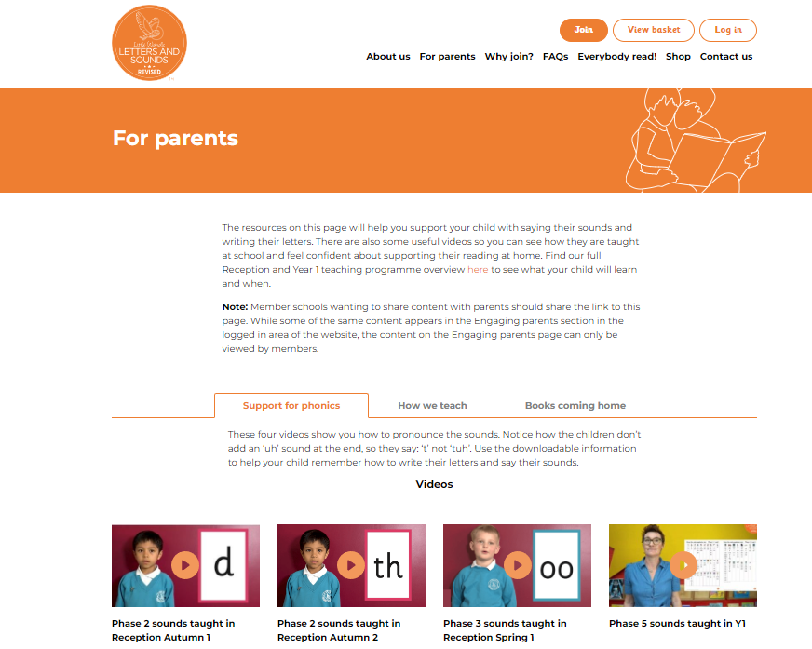
Phonics – Little Wandle
In Reception children will begin to have phonics lessons daily by week three. Reading sessions will start in class from week four with wordless books which then progress to phonic readers once the children begin to blend during their phonic lessons.
Extra small group and individual phonic lessons are taught to children who have not reached the expected stage and require extra support.
Phonics is taught through a scheme called Little Wandle Letters and Sounds Revised. It is directly linked levelled reading books used to practise phonic skills.
Visit the parent area of the site for more information:
https://www.littlewandlelettersandsounds.org.uk/resources/for-parents/

Slide 28
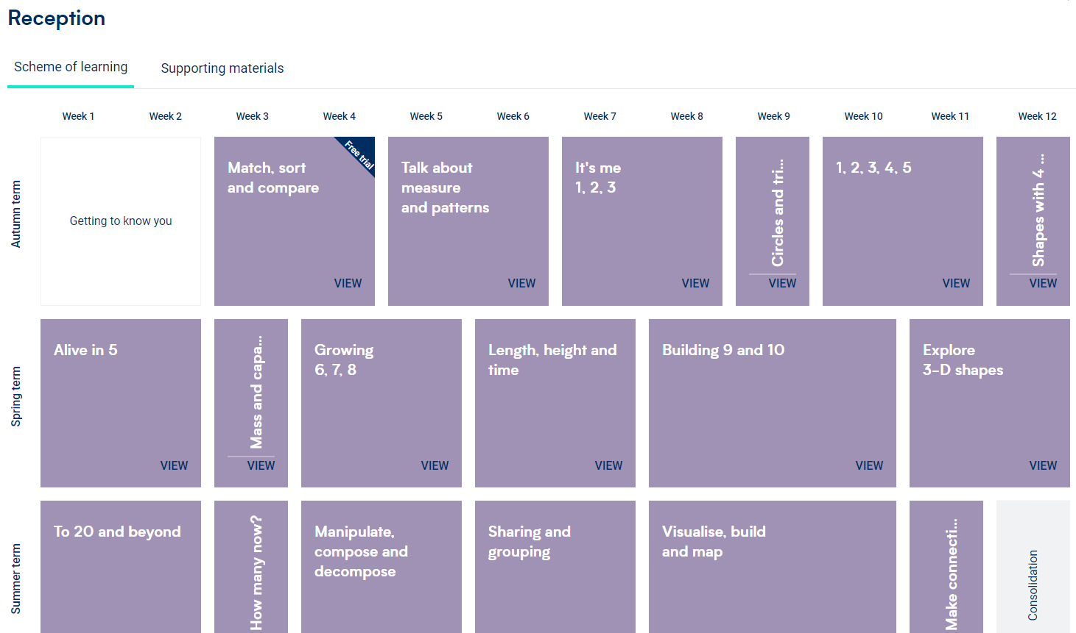
Maths – White Rose
We follow the White Rose Maths scheme from reception and this follows through to year six. The White Rose Scheme aims to instil positive attitudes to maths at an early age with maths resources that help children learn in fun, hands-on, practical ways. High-quality resources from White Rose Maths align perfectly with the DfE EYFS statutory framework including the early learning goals.

Slide 29
Final Notes
We know that your child’s first year at school is a huge step for both you and your child. We are here for you. We value each child as an individual and they are all important to us.
We are here to work with you, please come and see us if you would like to discuss something. Private appointments or informal chats are fine.
But Please wait until all the children are collected so we are not distracted as they are leaving.
Please only collect your own child. (unless prearranged with teacher)

