Slide 1
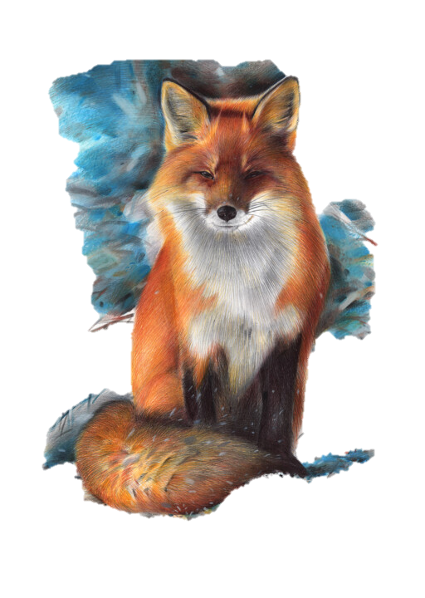

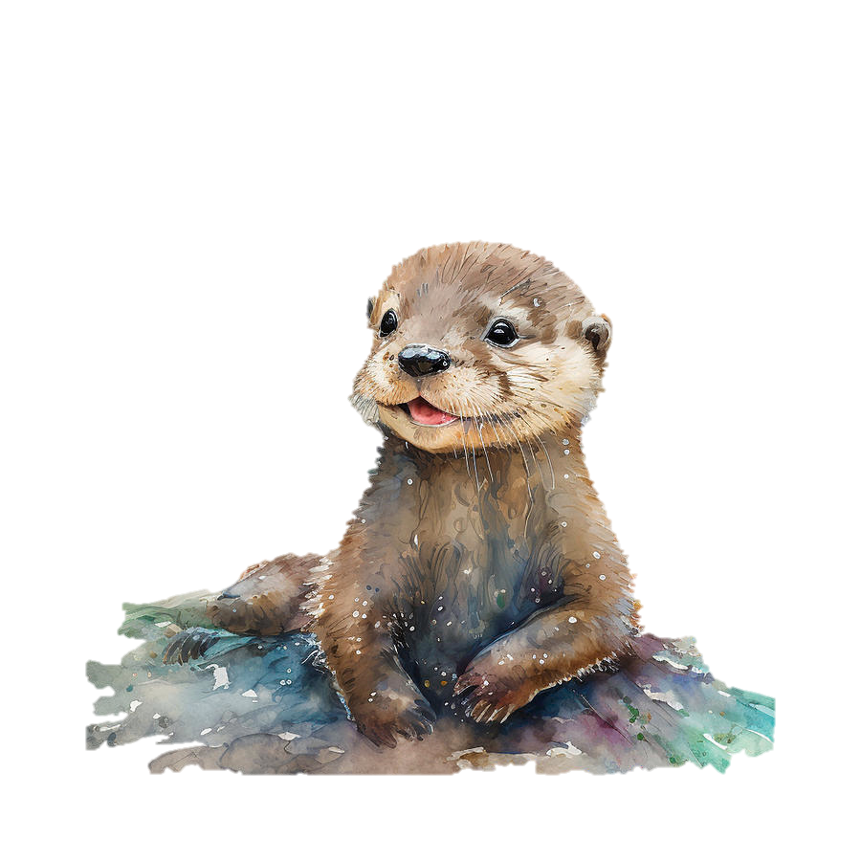
Welcome to Year 2

Slide 2
Year 2 Staff
Fox Class
Teacher: Miss Cygan & Miss Furiel
Teaching Assistant: Mr Bishop
Otter Class
Teachers: Mrs Baillie-Hopkins & Mrs Oxley
Teaching Assistant: Mrs Wheeler

Slide 3

Expectations
At Holy Trinity & St John’s we follow the 3 school rules; ready, respectful and safe.
Children are reminded what these look like and this is constantly being reinforced through-out the school.
This week we will be spending time embedding these within the classroom environment.

Slide 4




Holy Trinity Rewards
All children start the day on Bronze.
They are removed from Bronze if after a verbal warning they are still not responding and doing the right thing or if they have deliberately hurt another child.
Children can progress to silver, gold and HT champion during the day through showing good effort, achievement or acts of kindness.
House points are awarded at the end of the day according to where they finish on the chart.
Children also have opportunities to earn House points by meeting other class expectations.
Holy Trinity Champion – 5hps
Gold – 3hps
Silver – 2hps
Bronze – 1hp

Slide 5
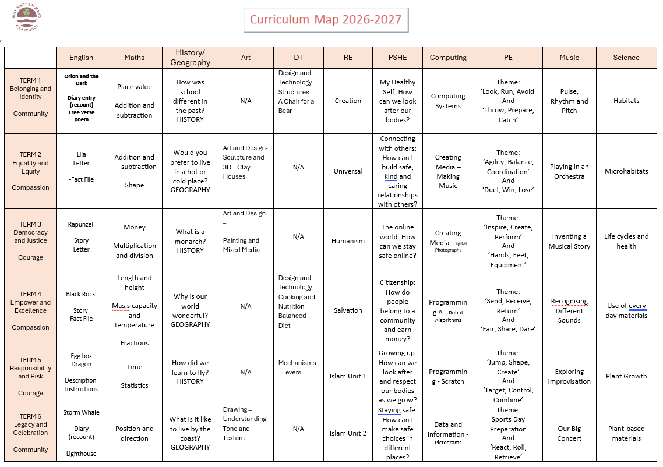
Year 2 Overview

Slide 6
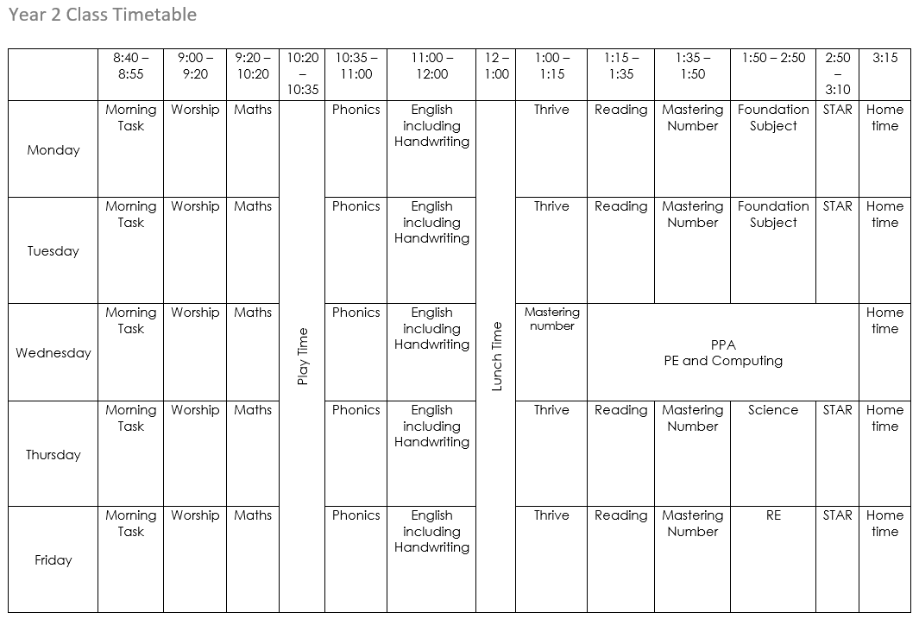
Year 2 Weekly Timetable

Slide 7
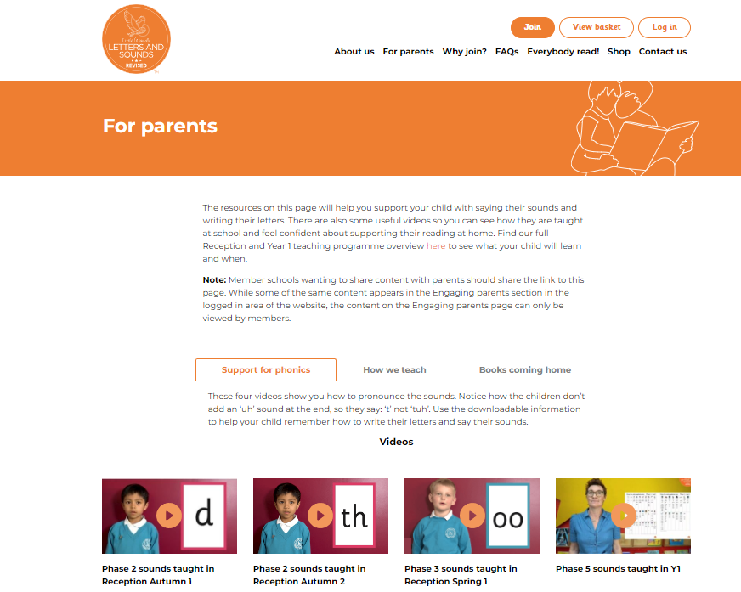
Little Wandle
In Year 2 children will continue to secure and build their phonic knowledge with daily lesson.
Extra small group and individual phonic lessons are taught to children who have not reached the expected stage and require extra support.
Phonics is taught through a scheme called Little Wandle Letters and Sounds Revised. It is directly linked levelled reading books used to practise phonic skills.
Children who did not pass the phonics screening check in Year 1 will be screened again at the end of Year 2.
Visit the parent area of the site for more information:
https://www.littlewandlelettersandsounds.org.uk/resources/for-parents/

Slide 8


Reading
Children have 2 -3 reading practise sessions per week,
to help build decoding, fluency and comprehension.
The reading books that are used are Collins Big Cat books from the Little Wandle programme and these are closely match to each child's ability (Children should be able to read them with ease).
Children will bring home a decodable Big Cat reading book that is numbered and they should be able to read this to you with little or no support. They will also bring home a share a story book they will chose to enjoy with you.

Slide 9
What can be done at home?
Reading The expectation is that children will read at least 3 times a week, with this being recorded in their reading records. This should be the phonic book they bring home. Children are awarded house points for each read recorded in their contact books
Maths Use Numbots online maths site – children have individual logins.
Spellings We will be introducing weekly spellings using Spelling Shed. This will be online and children will be given log ins.

Slide 10
Assessment Levels
Children are assessed for English and Maths at the end of each term using the criteria for the year they are working at. This will be done through a combination of formal and teacher assessments.
An average child will finish Year 1 as 1.6. The aim is that children will achieve 2.6 by the end of Year 2.
All children are different and learn at different rates, having different strengths and weaknesses.
Some children may not be working at the expected level and these children will be given extra support in class and where necessary through individual or small group interventions to help them reach the expected level for their age.

Slide 11
Most important!
Be Happy!
Each child is an individual and important to us.
We are here to work with you, please come and see us if you would like to discuss something. Private appointments or informal chats are fine.
But please wait until all the children are collected
so we are not distracted as they are leaving.
Please only collect your own child.
(unless prearranged with teacher)

