Slide 1

Welcome!
Year 6 – Hawk and Red Kite

Slide 2


RED KITE
Class 14
HAWK
Class 13

Slide 3
Year Six
Hawk
Teacher: Miss Armstrong
Teaching Assistants: Miss Welham, Mrs Yeroshenko
Red Kite
Teacher: Ms Wall
Teaching Assistant: Mrs Goodall
Year Group Additional Adults:
Mrs Douglas, Mr Williams, Miss Dingley

Slide 4

Our Values

Slide 5

Expectations

Slide 6
Expectations
Independent, resourceful
Attentive listeners
Hard working/trying their best
Growth Mindset
Follow the School Values
Behaviour : Working towards Trinity Champion/Trophy

Slide 7
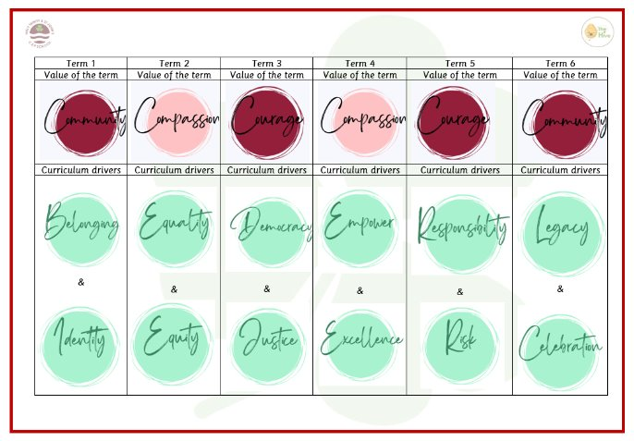
Our Curriculum Drivers

Slide 8
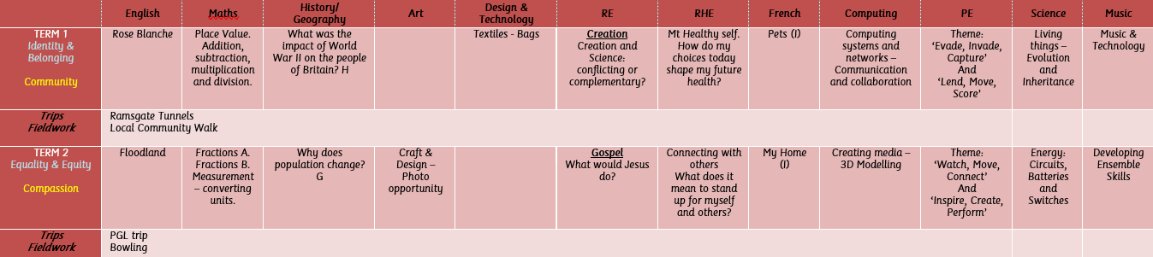
Our topics this year are…
Term 1 & 2

Slide 9
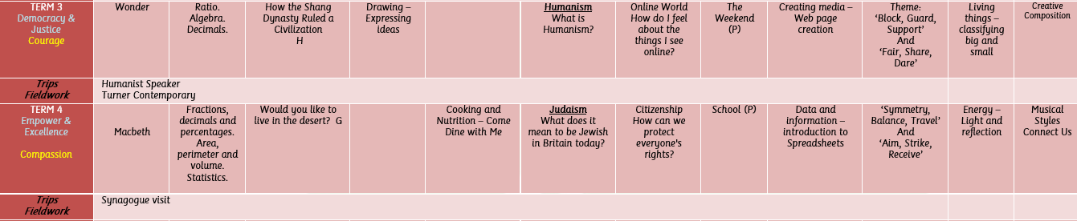
Our topics this year are…
Term 3 & 4

Slide 10
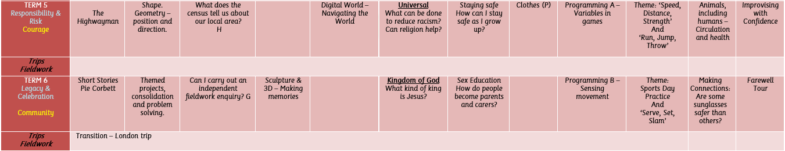
Our topics this year are…
Term 5 & 6

Slide 11
P.E.
In term 1– PE will be on Tuesday for Hawk (swimming).
In term 1- PE will be on a Thursday for Red Kite (with Ms Wall)
Please make sure that your child comes to school dressed in the correct PE kit (house coloured t-shirt) and has a water bottle. Lessons will take place outside weather permitting so a coat will be required.

Slide 12
Swimming - Tuesday
Hawk class will swim in term 1
Red Kite class will swim in term 2
Please ensure that your child comes to school dressed in their PE kit for swimming and is equipped with the required swimming kit (as per information/permission letter) and your child has a jumper/cardigan/fleece AND a coat.

Slide 13
Water and Snacks
It is very important for your child to have a water bottle with them in school.
Please make sure it is ONLY water that is being sent into school in a clearly labelled bottle (name and class number)
No snacks are provided in key stage 2. You can give your child a healthy snack for break time which they can eat on the playground.

Slide 14
Equipment
The children do have access to these items in school but we know that some like to bring in their own equipment. If so, these are the items that we use the most, in order to enable learning.
A pencil case with:
A pencil, a non-bendy ruler, pencil sharpener with lid, colouring pencils, glue (pritt stick), whiteboard pen (any colour), colouring pens if they wish.

Slide 15
General Everyday Homework
It is really important that you listen to your child read everyday! We expect your child to read at least 4 times a week. Contact books are provided for you to jot down when you have spent time listening to and discussing the text with your child. They can then quiz on their finished books using Accelerated Reader and their individual logins (links on class website page).
Spelling Shed homework will be set weekly online, linking to the spelling patterns in the National Curriculum.
We will be continuing our work with the 3/4 and 5/6 statutory spellings. Your child will be given the opportunity to learn these through additional activities in the classroom. Lists will been sent home for pupils to continue to practise at home.
TTRS – multiplication tables are at the epicentre of all our maths – please ensure your child is accessing TTRS or some other method of multiplication tables practice everyday!
Completing the above will earn housepoints for each child, their house totals and also weekly and termly rewards.

Slide 16
Mobile Phones/Walking Home
If your child is to walk home alone, we MUST have written permission, either a letter or an email from a parent.
If there is an odd day that you require your child to walk home alone, then a message to us or the office on that day is sufficient.
If a different family member other than a parent is due to collect your child, please let the office or us know.
Where pupils need to bring their mobile phones to school, they must be put in the box with Mrs Douglas on the playground and then will be kept in a locked box by the class staff. Phones will be returned to pupils at the end of the school day.
Your child should only bring in a phone if they are walking to or from school alone or if they have been at a different residence the night before and need to bring it in to school to return it back home.

Slide 17
Maths, GPS & Reading CGP Homework
All pupils will be given individual books to work through a section each week.
We will begin with the year 5 booklets up until the end of term 2 and then term 3 onwards the year 6 books will be provided to support their knowledge and understanding.
Homework will be set on a Friday and will need to be returned on a Wednesday. This gives the children plenty of time to ask for support from the class adults before the due date.

Slide 18
Thank you
We would like to thank you for taking the time to come in today.
Please, if you have any questions, queries or concerns during the school year, catch us at the end of the day or book an appointment through the school office; communication for us is key!
You can also email us on:
hawk@htsj.school
redkite@htsj.school
year6@htsj.school

